Slide 1
Lesson 3.7 Oil Spill Response Options
CGPRT(W) : Ensuring Clean Seas and Coasts in Western Region ……

Slide 2
Objective
Provide an overview of oil spill response options;
Provide information on advantages and disadvantages of each option; and
Provide a methodology to select the appropriate response options.
CGPRT(W) : Ensuring Clean Seas and Coasts in Western Region ……

Slide 3
Response Objective
The overall objective of oil spill response is to minimize impacts on:
Biological resources
Economic activities
Human use of shoreline
A limited number of response options are available to achieve this objective
No universal option!
Oil type, weather conditions and oil trajectory will affect choices
CGPRT(W) : Ensuring Clean Seas and Coasts in Western Region ……

Slide 4
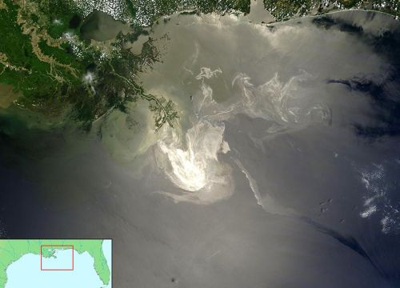
Response Options
The following response options are available to responders:
Aerial surveillance, tracking and forecasting
Protection of sensitive resources
Containment and recovery
Dispersants
In situ burning
Shoreline clean-up
CGPRT(W) : Ensuring Clean Seas and Coasts in Western Region ……

Slide 5
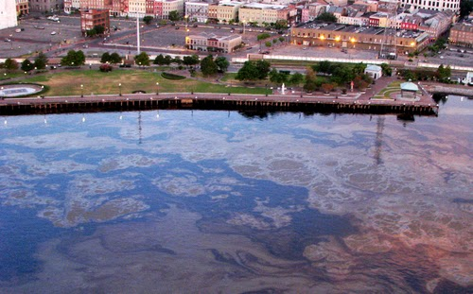
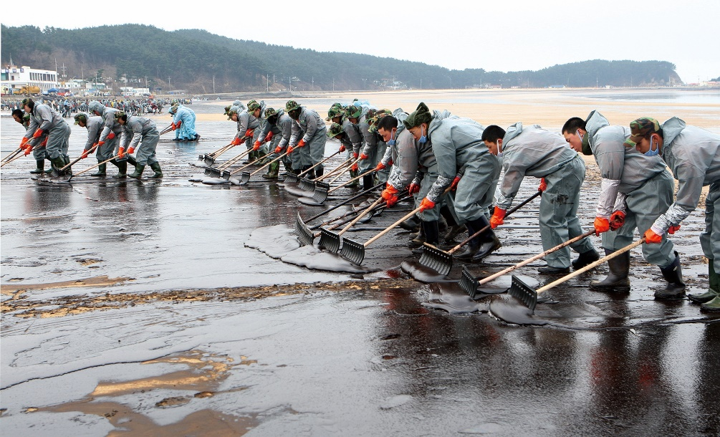
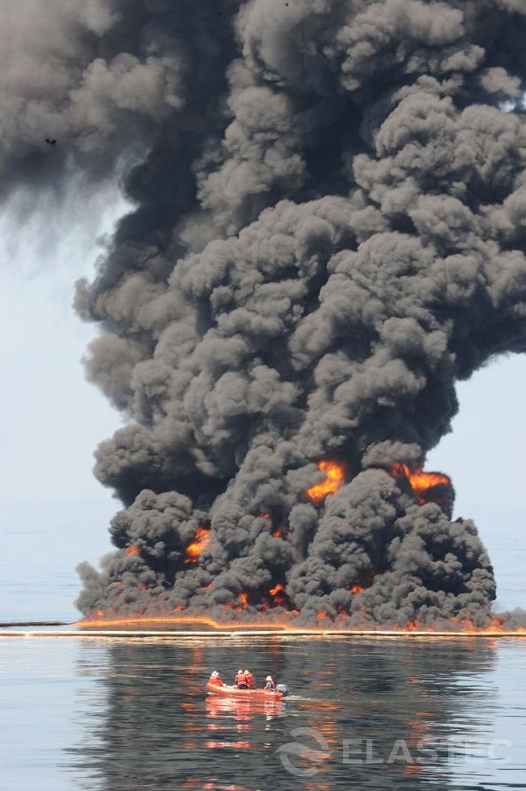
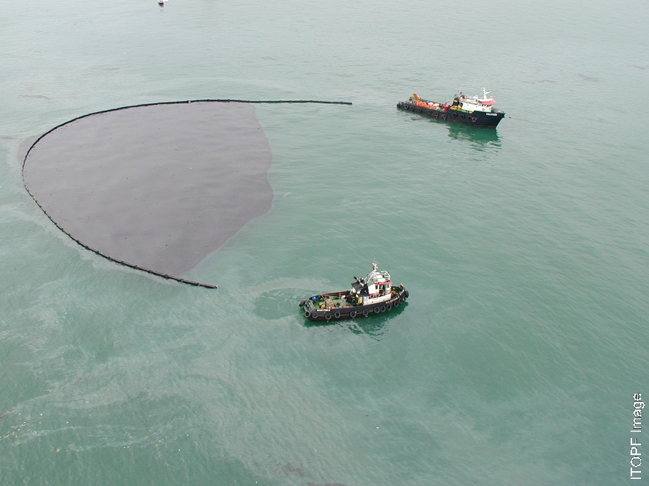
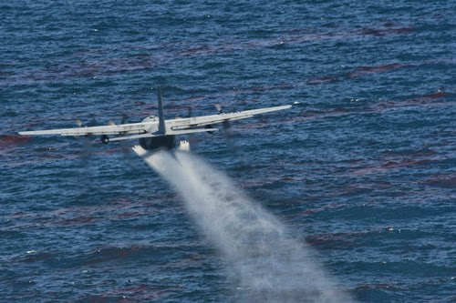
Response Options
CGPRT(W) : Ensuring Clean Seas and Coasts in Western Region ……

Slide 6
Aerial observation
CGPRT(W) : Ensuring Clean Seas and Coasts in Western Region ……

Slide 7
Aerial Observation
First response option
Collect key information about the spill:
Confirm source;
Scale of spill;
Oil trajectory;
Oil behaviour;
Support equipment deployment; and
Strategic planning
CGPRT(W) : Ensuring Clean Seas and Coasts in Western Region ……

Slide 8
Aerial observation
Satellites, helicopter, fixed wing aircraft and unmanned aerial vehicles
Trained observers or sensors (UV, SLAR, IR, etc.)
Safety (twin engine aircraft)
Must relay information quickly to command centre
CGPRT(W) : Ensuring Clean Seas and Coasts in Western Region ……

Slide 9
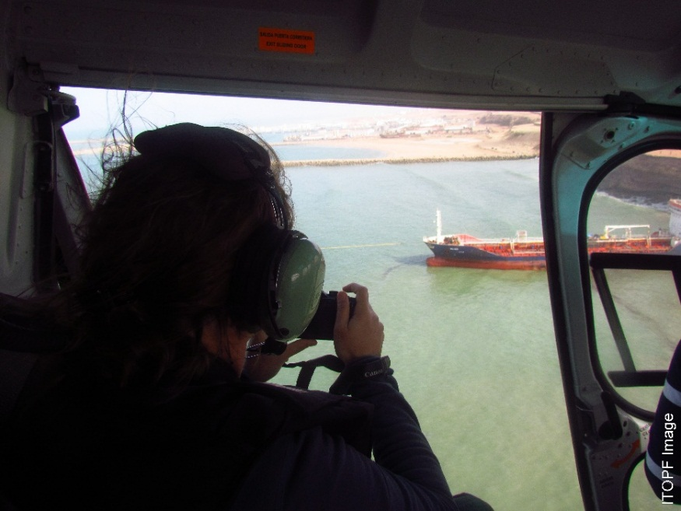
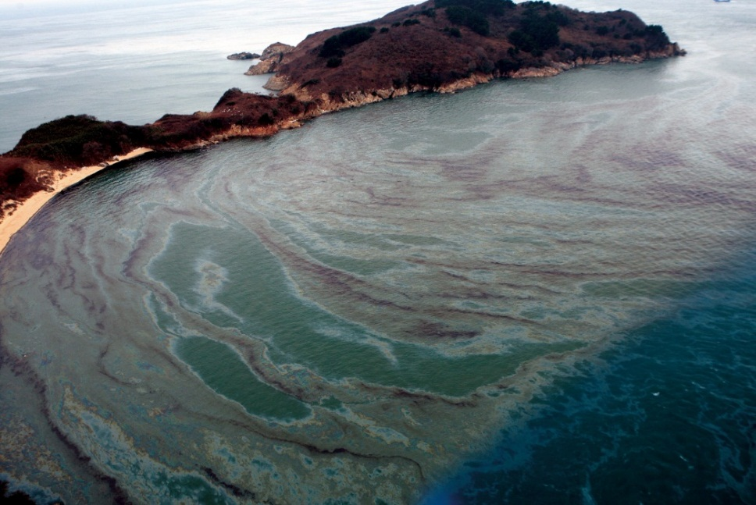

Aerial observation
CGPRT(W) : Ensuring Clean Seas and Coasts in Western Region ……

Slide 10
Protection of Sensitive Resources
CGPRT(W) : Ensuring Clean Seas and Coasts in Western Region ……

Slide 11
Protection of Sensitive Resources
Prevent contamination of important areas using booms
Biological (e.g. marshes)
Economic (e.g. marina)
Requires prioritization of sensitive resources
Importance of sensitivity maps
Good use of limited resources (booms)
High benefits for low costs
CGPRT(W) : Ensuring Clean Seas and Coasts in Western Region ……

Slide 12
Protection of Sensitive Resources
Limited by availability of booms
Limited by booms’ failure conditions
Strong currents (more than 1 knot)
Weather conditions (waves)
Limited protection for large sensitive areas
Deployed boom length is limited
Requires maintenance once deployed
Effective response options for more sheltered nearshore environments
CGPRT(W) : Ensuring Clean Seas and Coasts in Western Region ……

Slide 13
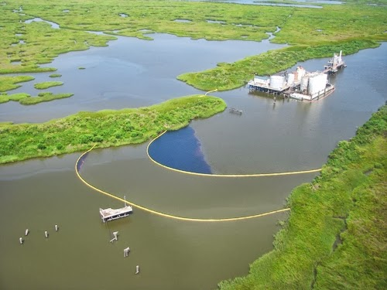
Protection of Sensitive Resources
CGPRT(W) : Ensuring Clean Seas and Coasts in Western Region ……

Slide 14
A few Words on Booms
Booms are an essential tool for oil spill response
Shoreline protection and containment of oil
Many types of booms on the market
Solid flotation vs. inflatable
Offshore vs. nearshore
Newer systems: ocean and current busters
Will fail in some conditions
Strong currents (more than 1 knot)
Weather conditions (waves)
CGPRT(W) : Ensuring Clean Seas and Coasts in Western Region ……

Slide 15
A few Words on Booms
Booms deployment requires substantial logistics
Transportation (boats, trucks)
Trained personnel
Maintenance
CGPRT(W) : Ensuring Clean Seas and Coasts in Western Region ……

Slide 16
Containment and Recovery
CGPRT(W) : Ensuring Clean Seas and Coasts in Western Region ……

Slide 17
Containment and Recovery
Objectives: stop spreading, concentrate and remove oil from the environment
Equipment required:
Booms;
Skimmer(s) with power pack;
Vessel(s) to pull booms and transport equipment
Storage tank for recovered oil/oily water
Significant investment up front
Substantial logistics
CGPRT(W) : Ensuring Clean Seas and Coasts in Western Region ……

Slide 18
Containment and Recovery
Success is limited by:
Weather conditions for booms operation (current, sea state)
Deployment time
Encounter rate with oil
Storage capacity
Debris
For larger offshore spills, containment and recovery of more than 10% may be difficult to achieve.
CGPRT(W) : Ensuring Clean Seas and Coasts in Western Region ……

Slide 19
A few Words on Skimmers
It is basically a floating pump
Many different types on the market
Weir
Oleophillic
Vacuum
Mechanical
Limitations:
Oil type
Sea state and weather
Amount of debris
Transport
CGPRT(W) : Ensuring Clean Seas and Coasts in Western Region ……

Slide 20
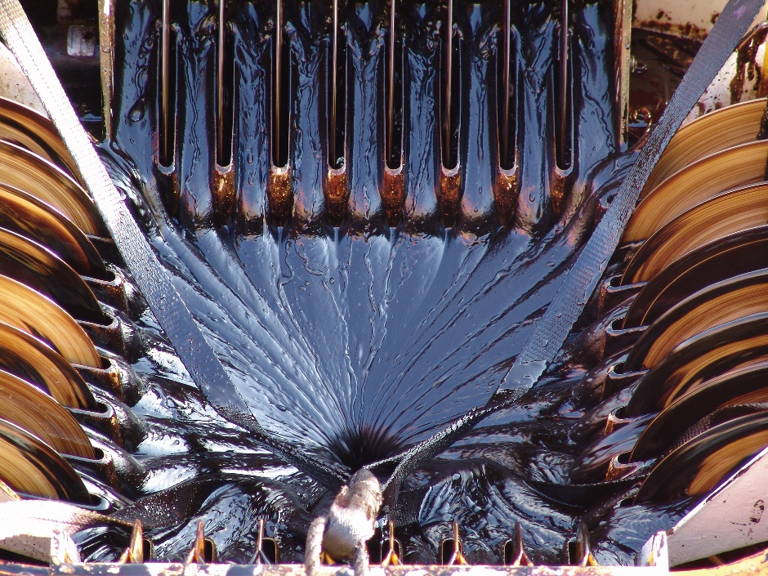
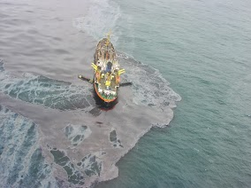
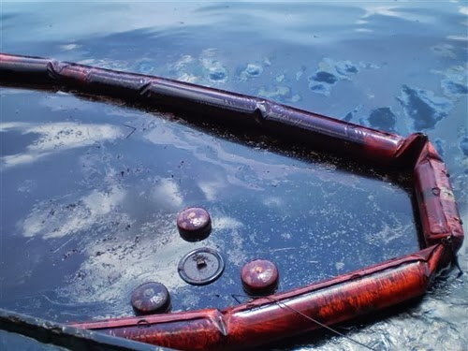
Skimmers
CGPRT(W) : Ensuring Clean Seas and Coasts in Western Region ……

Slide 21
Dispersants
CGPRT(W) : Ensuring Clean Seas and Coasts in Western Region ……

Slide 22
Dispersants
Objective: Promote natural dispersion of oil into water column.
Dispersants are chemical products formulated to produce 10s-microns-size oil droplets that will be dispersed, diluted and eventually biodegraded in the environment.
New generations of dispersants have low toxicity and high efficiency.
CGPRT(W) : Ensuring Clean Seas and Coasts in Western Region ……

Slide 23
Dispersants
How dispersants work
Chemical formulation to reduce interfacial surface tension between oil and water
Oil will form 10s-microns-size droplets because of mixing energy from waves
Because of their small size, these droplets will remain suspended in water column as a plume
Plume will be diluted by mixing energy and currents
Increase biodegradation due to larger surface area for bacteria
CGPRT(W) : Ensuring Clean Seas and Coasts in Western Region ……

Slide 24
Dispersants
Application by aircraft or boats
Aircraft
Plane or helicopter
Wide coverage
Trained pilots
Boats
Small local response
CGPRT(W) : Ensuring Clean Seas and Coasts in Western Region ……

Slide 25
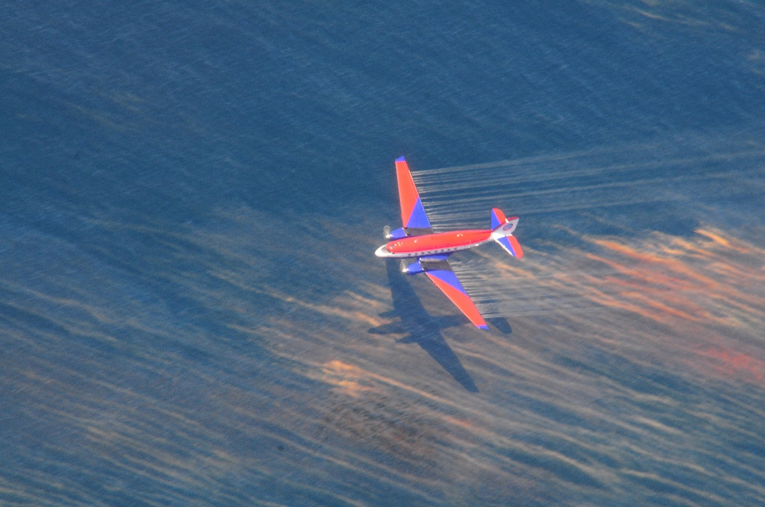
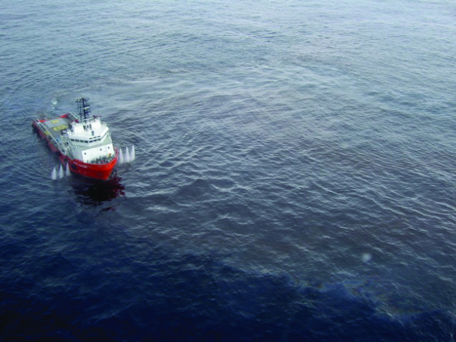
Dispersants
CGPRT(W) : Ensuring Clean Seas and Coasts in Western Region ……

Slide 26
Dispersants
Issues with dispersants use
Toxicity
Dispersants have lower toxicity than dispersed oil
Field test have shown higher oil concentrations in 0 to 10 m water depth
Background oil concentration within hours
Short duration exposure because of dilution
Oil viscosity and dispersibility
Readily dispersible for oil viscosity below 5,000cSt
Moderate for oil viscosity between 5,000–10,000cSt
Likely to be ineffective above 10,000cSt
CGPRT(W) : Ensuring Clean Seas and Coasts in Western Region ……

Slide 27
Dispersants
Issues with dispersants use
Oil viscosity and time
Weathering processes will increase oil viscosity over time
Dispersants must be applied before viscosity is too high
“Window of opportunity”
Sea state and weather
Typically requires between 3 to 18 m/s wind speed and 0.5 to 5 m wave height
Weather conditions must permit application of dispersants
CGPRT(W) : Ensuring Clean Seas and Coasts in Western Region ……

Slide 28
Dispersants
Issues with dispersants use
Government approval
Usually required by national regulations
List of approved dispersants
Criteria for application
Dispersants use policy
Application zones
Not in shallow water (less than 10 to 20 m)
Not near water intakes
Mainly offshore
Net environmental benefit
CGPRT(W) : Ensuring Clean Seas and Coasts in Western Region ……

Slide 29
Dispersants
Advantages
Elimination of oil from sea surface
Protection of birds and shoreline
Improve biodegradation of oil
Does not generate waste
Quick response (if in contingency plan)
Reasonable costs for potentially high benefits
CGPRT(W) : Ensuring Clean Seas and Coasts in Western Region ……

Slide 30
In situ burning
CGPRT(W) : Ensuring Clean Seas and Coasts in Western Region ……

Slide 31
In Situ Burning
Objective: Remove oil from sea surface by ignition
Required equipment:
Vessels
Fire resistant booms
Can eliminate significant quantity of oil rapidly
Minimize waste generation
Especially efficient for spill in ice
CGPRT(W) : Ensuring Clean Seas and Coasts in Western Region ……

Slide 32
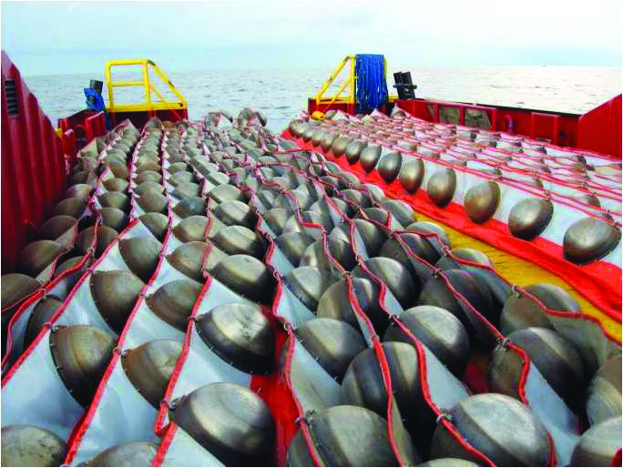
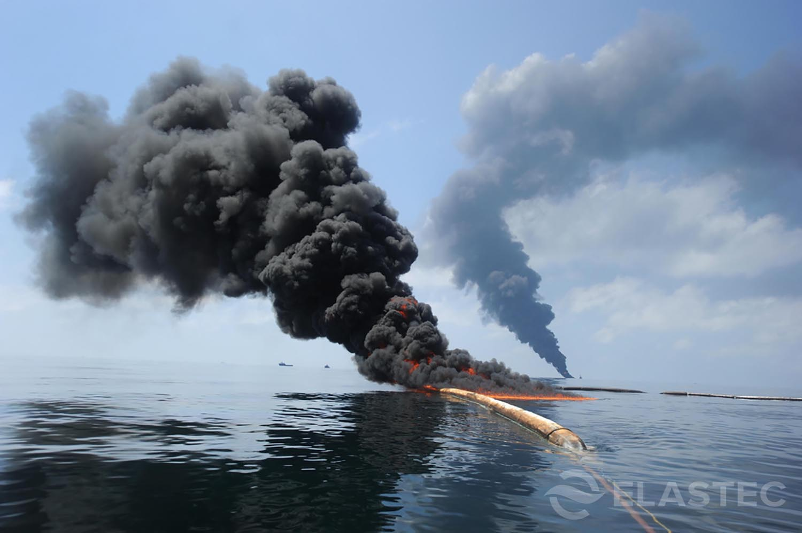
In Situ Burning
CGPRT(W) : Ensuring Clean Seas and Coasts in Western Region ……

Slide 33
In Situ Burning
Issues with in situ burning
Availability of fire resistant booms
Oil thickness
A minimum of 2 mm required to sustain burn
If less than 2 mm, burning will stop
Smoke plume
Smoke = gas, CO₂, particulates
Avoid exposure to smoke
Must be aware of sensitive resources that might be exposed to smoke plume
CGPRT(W) : Ensuring Clean Seas and Coasts in Western Region ……

Slide 34
In Situ Burning
Issues with in situ burning
Oil weathering
High viscosity oil can be harder to ignite
Burn residue
Heavy burn residue possible
Can be difficult to recover and sink in some cases
Safety
Fire can spread to adjacent structures, vessels
Exclusion zone
Avoid exposure to smoke
CGPRT(W) : Ensuring Clean Seas and Coasts in Western Region ……

Slide 35
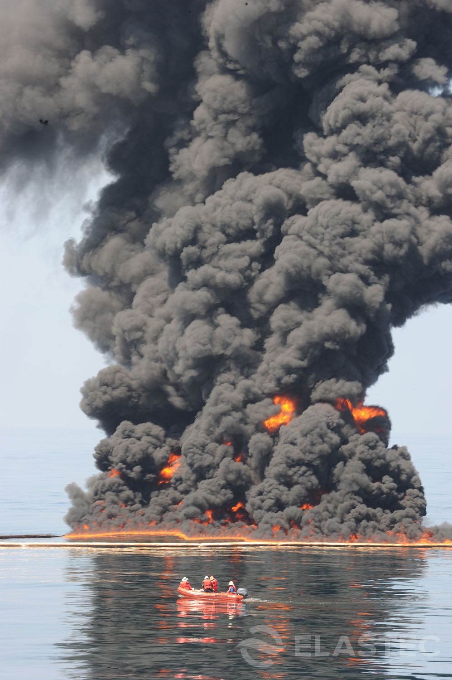
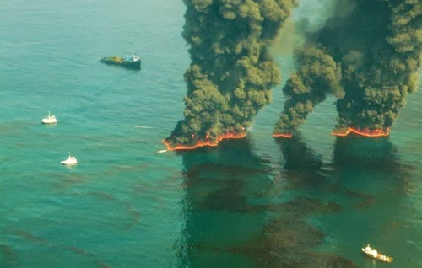
In Situ Burning
CGPRT(W) : Ensuring Clean Seas and Coasts in Western Region ……

Slide 36
Shoreline Clean-up
CGPRT(W) : Ensuring Clean Seas and Coasts in Western Region ……

Slide 37
Shoreline Clean-up
Objective: Remove oil from shoreline without causing additional damage
Various techniques available
Natural
Manual
Mechanical
Flooding/low pressure
High pressure
CGPRT(W) : Ensuring Clean Seas and Coasts in Western Region ……

Slide 38
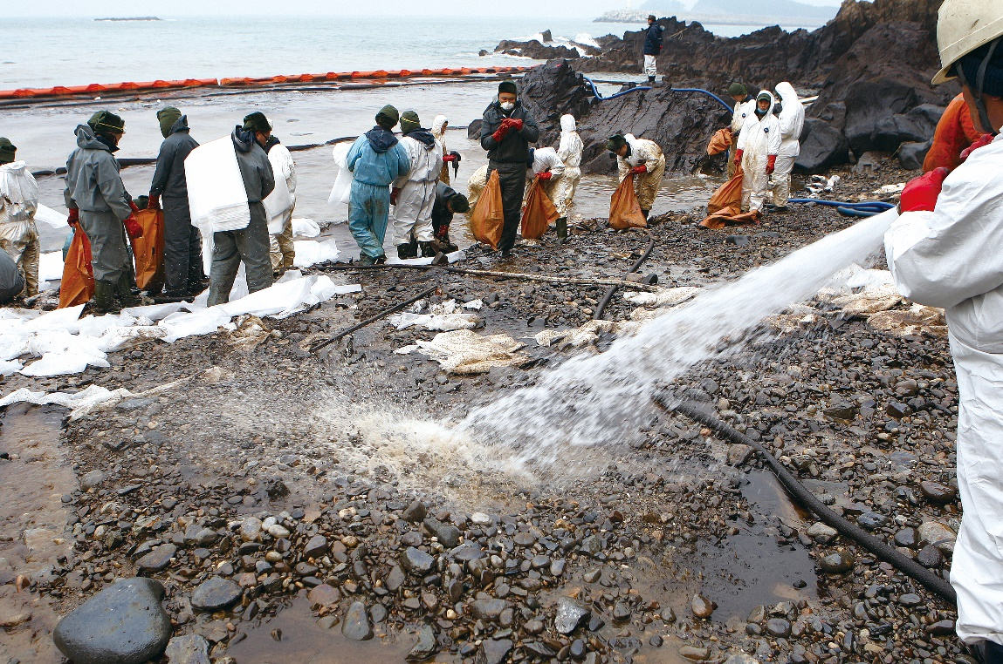
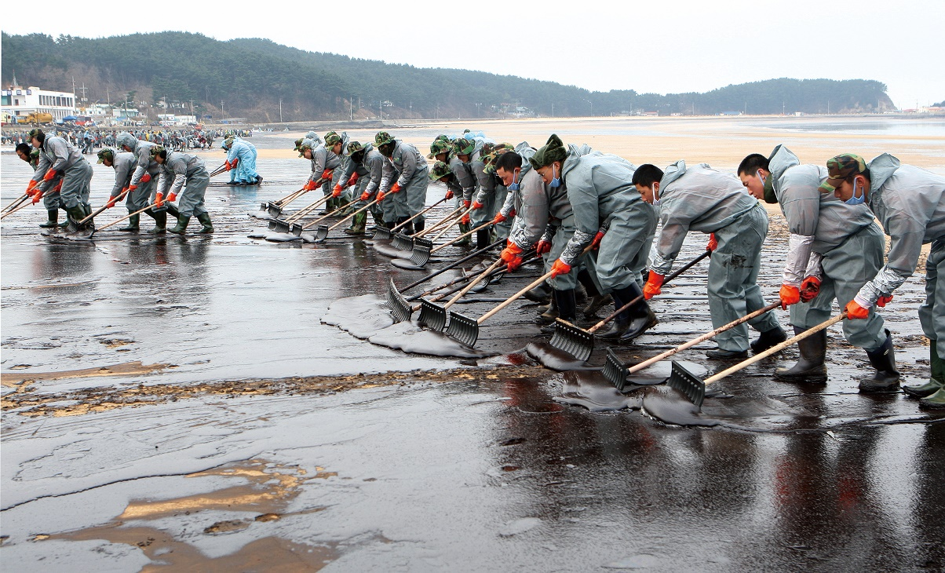
Shoreline Clean-up
CGPRT(W) : Ensuring Clean Seas and Coasts in Western Region ……

Slide 39
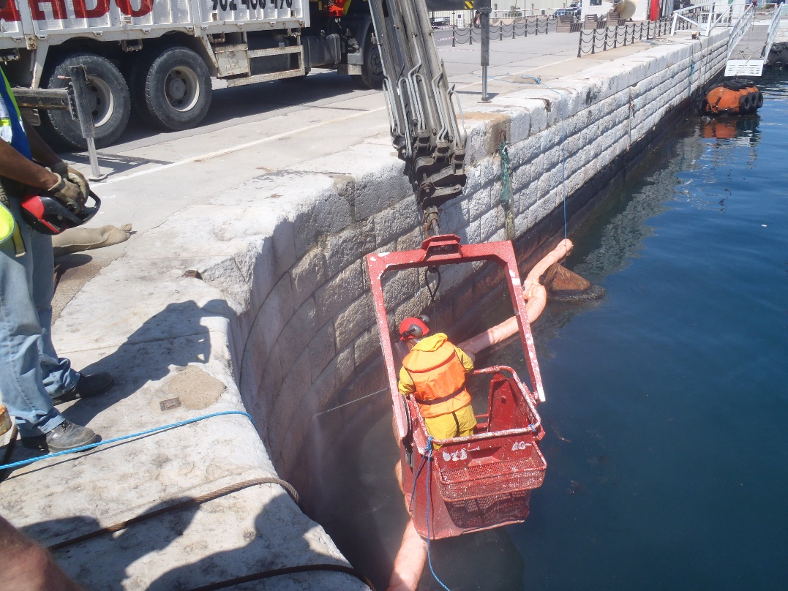
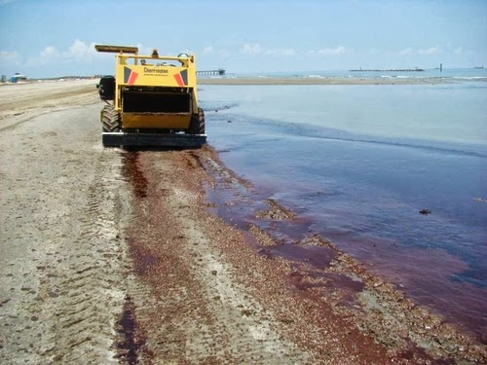
Shoreline Clean-up
CGPRT(W) : Ensuring Clean Seas and Coasts in Western Region ……

Slide 40
Shoreline Clean-up
Shoreline clean-up strategy
Evaluation
Survey (shoreline types, degree of oiling)
Shoreline Clean-up Assessment Technique (SCAT) process
Identify priorities
amenity vs. environment
response speed vs. aggressiveness
Establish shoreline clean-up end-points
Implement clean-up
CGPRT(W) : Ensuring Clean Seas and Coasts in Western Region ……

Slide 41
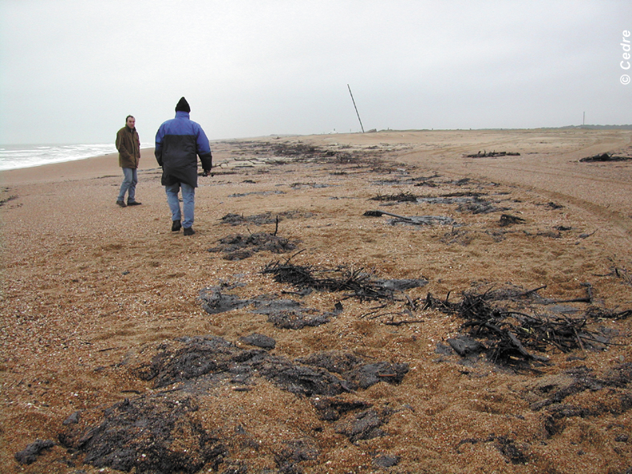
Shoreline Survey
CGPRT(W) : Ensuring Clean Seas and Coasts in Western Region ……

Slide 42
Shoreline Clean-up
Shoreline clean-up strategy
Re-evaluate shoreline
Does shoreline meets end-point criteria?
If yes, stop
If no, identify new method
Must balance between aggressiveness and potential damages from clean-up
CGPRT(W) : Ensuring Clean Seas and Coasts in Western Region ……

Slide 43
Shoreline Clean-up
Oil plentiful in the early stages:
high volume of oil treatment
As clean-up brought to a close:
very little oil remains
At some point the costs of oil treatment are disproportionate to the benefits
Oil Treated
Clean-up Effort
CGPRT(W) : Ensuring Clean Seas and Coasts in Western Region ……

Slide 44
How to Select a Response Strategy?
Identify priorities
Protection of public
Sensitivities
Economic
Social
Environmental
Know your limiting factors
Type of oil
Weather and sea conditions
CGPRT(W) : Ensuring Clean Seas and Coasts in Western Region ……

Slide 45
How to Select a Response Strategy?
Net Environmental Benefits
Compare overall impacts of each response option against no intervention
Select suite of response options that minimize overall impact
Do you have the necessary operational capacity?
Command and control structure
Availability of equipment/personnel
Logistics and deployment time
Implement response strategy
Evaluate success and re-assess
CGPRT(W) : Ensuring Clean Seas and Coasts in Western Region ……

Slide 46
Conclusion
Various response options available for oil spills
None of these options are perfect
each has benefits and limitations
You are likely to use a combination of methods
At the strategic level, you must know available options, their
benefits, limitations and impacts.
CGPRT(W) : Ensuring Clean Seas and Coasts in Western Region ……

Slide 47
Any questions?
CGPRT(W) : Ensuring Clean Seas and Coasts in Western Region ……

